Slide 1
Service Assured – Electric
Program Enhancements

Slide 2
Program Benefits to Customers
Service Assured is a utility managed service agreement program in place since 1999. For a monthly fee, the program:
Provides peace of mind to avoid unexpected expensive repairs
Mitigates the hardship of unexpected costly service repairs ($500 - $4,000 typical)
Provides a clear starting point for repair work, permits, and inspections
Additional Customer Benefits that result from the proposed enhancements include:
Remedy for anticipated failures found during upcoming AMI deployment
Program becomes inclusive regardless of underground or overhead services

Slide 3
Program Benefits to RPU
Offers customers a non-commodity, value-added service with low utility investment
Provides crews a way to talk with customers about unexpected expensive repairs
Facilitates relationships with contractors and electrical inspectors
Additional RPU Benefits that result from the proposed enhancements include:
Expansion of a valuable service to more residential customers
Manages customer relationship risk for anticipated failures found during AMI deployment
Expands revenue to cover these likely costs

Slide 4
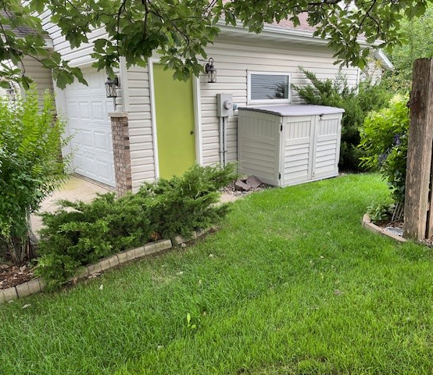
Typical Underground Service
Subjected to:
Frost heaves, rodent damage, wet conditions, and excavation damage
Complications include:
Hard and soft landscaping
Paved sidewalks and driveways
Decks and other building additions

Slide 5
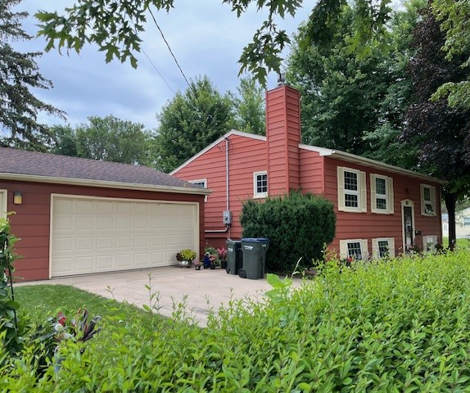
Typical Overhead Service
Subjected to:
Tree damage, UV deterioration, other age-based damages
Complications include:
Backyard access
Private property trees

Slide 6
Program Eligibility – Evolution
The program’s past eligibility focused on the type and ownership of the service:
Underground
Services constructed or upgraded after January 1, 1981, are customer owned
Overhead (Presently Not Eligible for Service Assured)
Service equipment from house weather head to meter are customer owned
In 2021, RPU Water upgraded their program to become an All in – Opt out approach. Electric customer participation remained voluntary only.

Slide 7
Program Eligibility – Single Family Homes
Underground customer-owned electric services – 17,385
Present voluntary participation in SA-Electric – 4,716 (27%)
Underground RPU-owned electric services – 3,328
These services are already RPU’s responsibility to repair.
Overhead customer-owned electric services – 11,183
Presently excluded from the program. Proposed enhancements reach these customers
All in – Opt out participation could reach 31,900 or 58% of residential customers.

Slide 8
Reasons to Expand Program for Overhead Services
Customer needs are high as they recover from a damaging storm – no present remedy
Reaching a broader group of customers and neighborhoods
Overhead services are generally older with more potential for deterioration
Providing this beneficial program regardless of type of electrical service

Slide 9
Risk Management
Historically, RPU mitigated the risk of expensive underground repair claims through complicated eligibility criteria coupled with on-site inspections that disqualified customers after their application was submitted.
Proposed program mitigates expensive claims risk by capping the benefit per customer.

Slide 10
Proposed Coverage – Underground and Overhead Services
Repair of customer-owned wires, conduits
Essential underground boring or trenching to facilitate efficient repairs
Limited restoration work on private property
Repair of customer-owned meter socket (new)
Replacement of the old meter socket with a new bypass meter socket (new)
Replacement of damaged house riser conduit and weather head (new)
Repair coverage limited to $3,000 – electrical repair expenses only, plus $750 for lever bypass meter socket upgrade.

Slide 11
Utility Board Action Requested
Staff recommends implementation of an All in – Opt out approach to the Service Assured program for overhead and underground residential electrical customers.
Upon direction of the Board, staff will move forward with program implementation details aligned with an intended deployment of January 1, 2025.
Staff will include the related costs in the 2025 revised budget to be presented at the special August 6, 2024, Board meeting.

Slide 12
THANK YOU

