Slide 1
Water Main Replacement Analysis Results August 28, 2018

Slide 2
Water Main Replacement Prioritization Study Goals
Develop tool for focused replacement based on condition, not age
Provide basis for determining future budgets based on service level goals
Establish metric-driven capital improvement plan based on risk (likelihood and consequence of main failures)
Form collaborative approach with Public Works for mutually beneficial projects

Slide 3
Main Break Analysis
01
Notes:
To hit those goals, need to dive into the break history and data

Slide 4
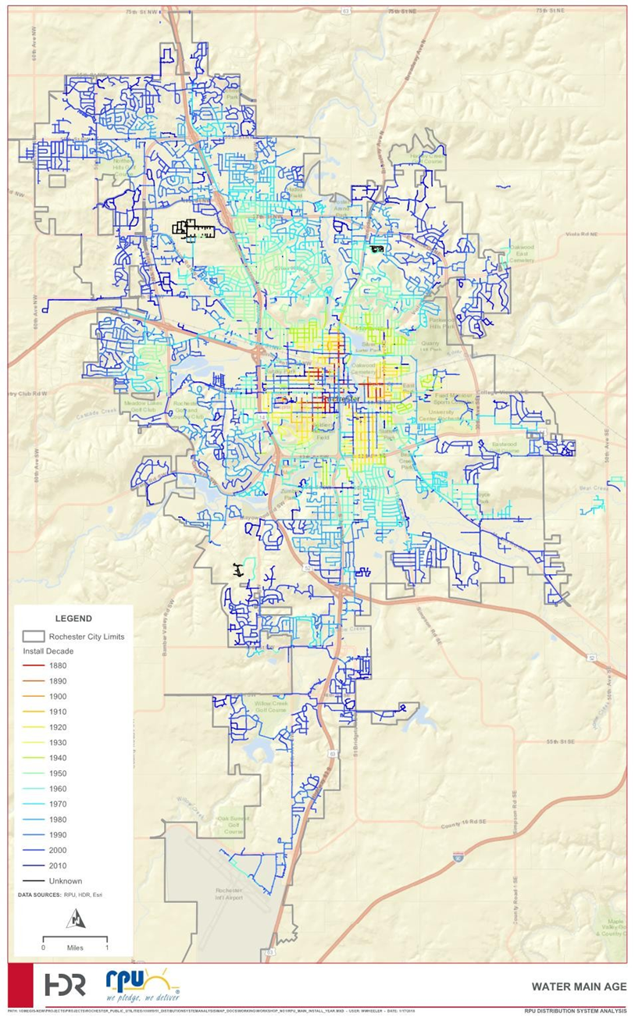
RPU System
Growing system:
Grown from under 300 miles in 1988 to currently ~600 miles
Low break rate (or number of breaks per 100 miles)
Approximately 8 (5-year average)
Pipe diameters in the RPU system range from 0.75 to 24 inches

Slide 5
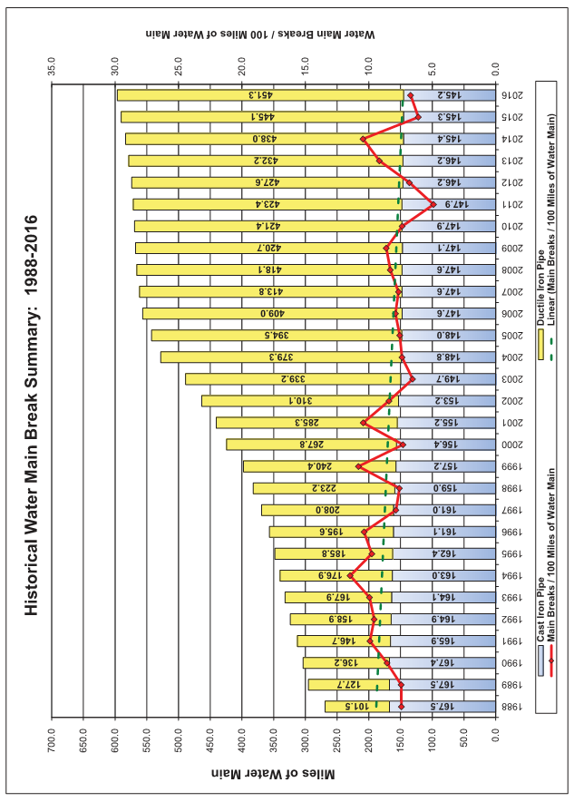
Historical Water Main Break Summary: 1988-2016
Water Main Breaks / 100 Miles of Water Main
Miles of Water Main
Notes:
At system level, break rate looks relatively flat

Slide 6
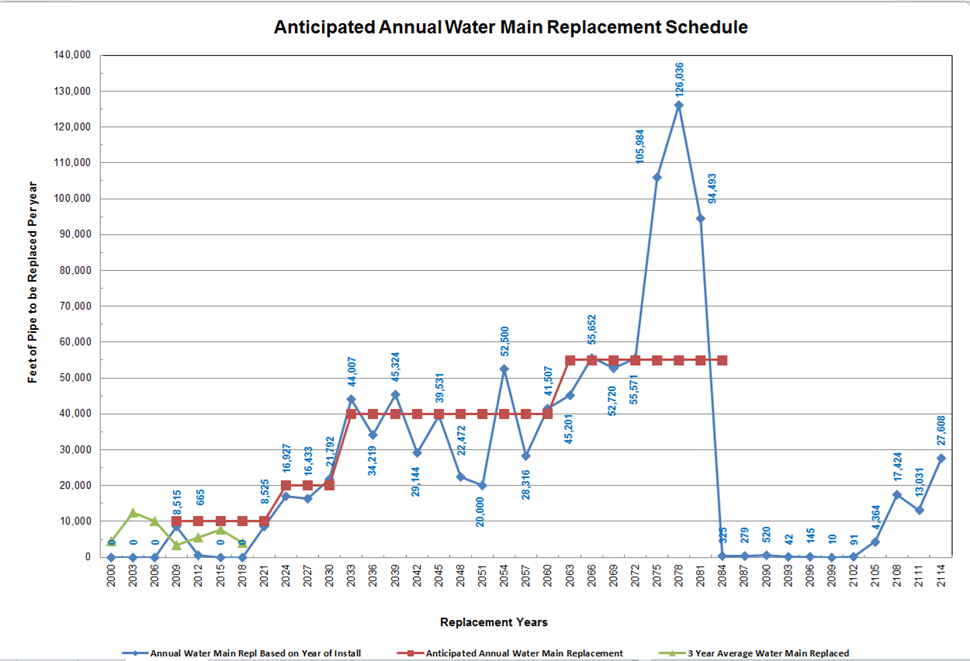
Anticipated Annual water main replacement schedule
Feet of Pipe to be Replaced Per Year
Replacement Years
Notes:
If you look at the problem simply from a age based replacement, there is a coming “wave” of replacement needs.
This is typical for a number of facilities.
To make sure RPU gets highest ROI, we look at this from a risk perspective.

Slide 7
Main Break Analysis
Potential primary and secondary drivers of water main deterioration
Material Vintage (age and material)
Diameter
Soil Data (Shrink/Swell, Steel Corrosion, & Frost Heave)
Pressure
Number of Taps
Proposed groupings, or cohorts, based on analysis of RPU data
Notes:
Risk-based; not age based

Slide 8
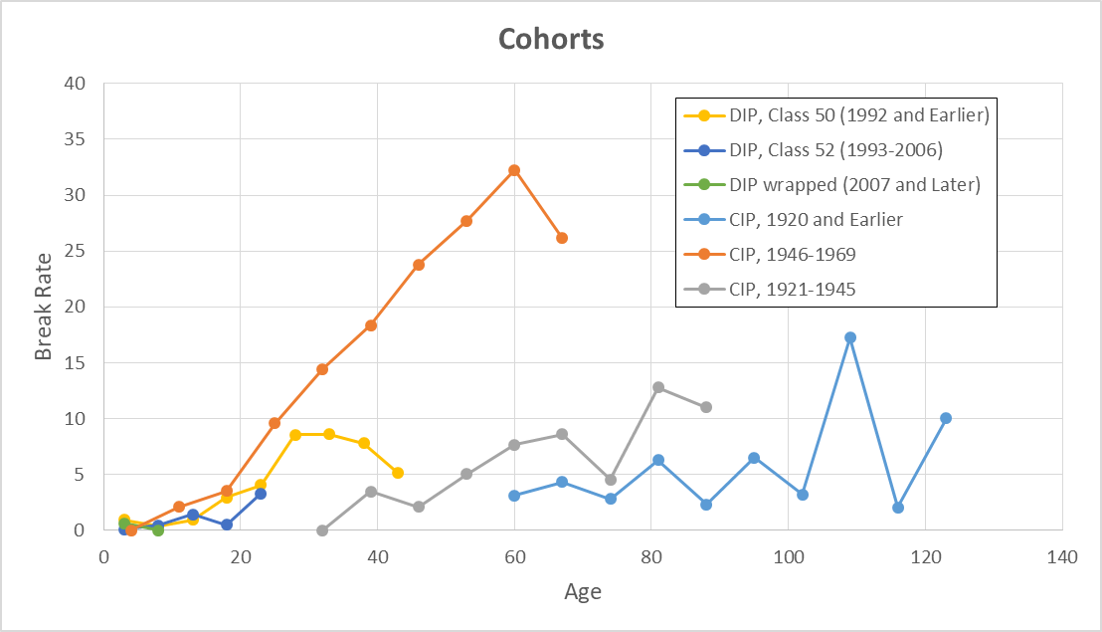
Notes:
If replacement is based purely on age, there is a significant difference in performance. For example, CIP installed in 1918 (on average) has a break rate of under 5 as compared to CIP installed in 1958 with a break rate of over 30.

Slide 9
Benchmarking
02

Slide 10
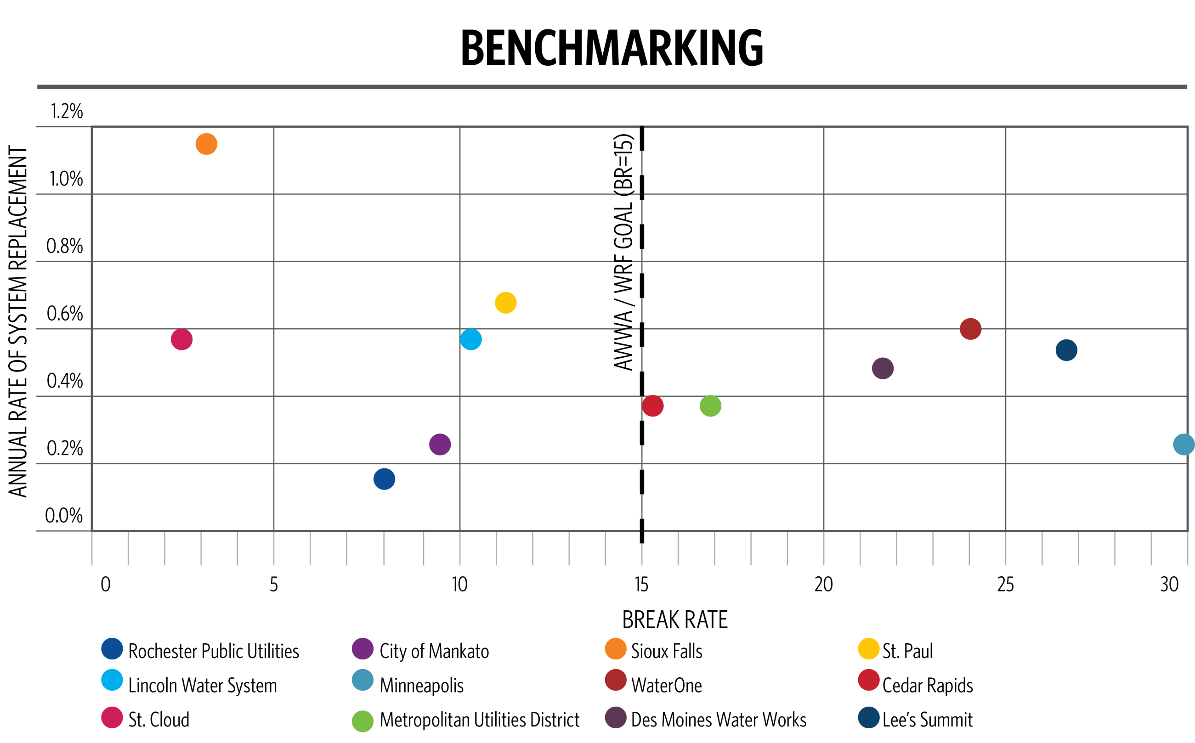
Notes:
Ahead of the AWWA goal, but want to stay there

Slide 11
Break Forecast
03

Slide 12
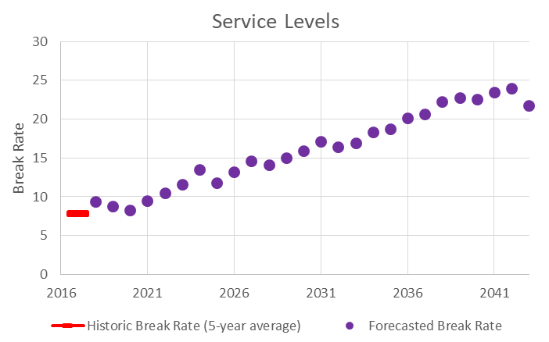
Baseline – Replacements Sorted By Age
Break Rate = 23
5-year average for 2039-2043
Almost 200% increase over existing
Notes:
All the forecasts are based on the break history; more breaks increase

Slide 13
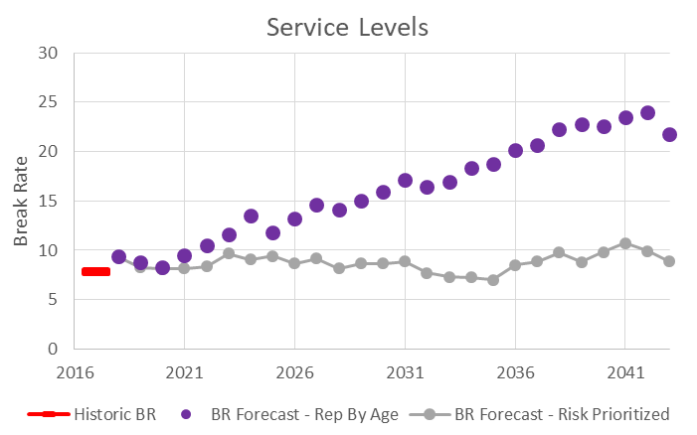
Prioritizing Investments – Assumes 100% Eff.
Same amount (i.e. length) of annual replacement
Break rate = 10
~23% increase over existing
Potential Value of Risk Prioritization
Notes:
Providing better “customer service” for same investments
Doug to insert

Slide 14
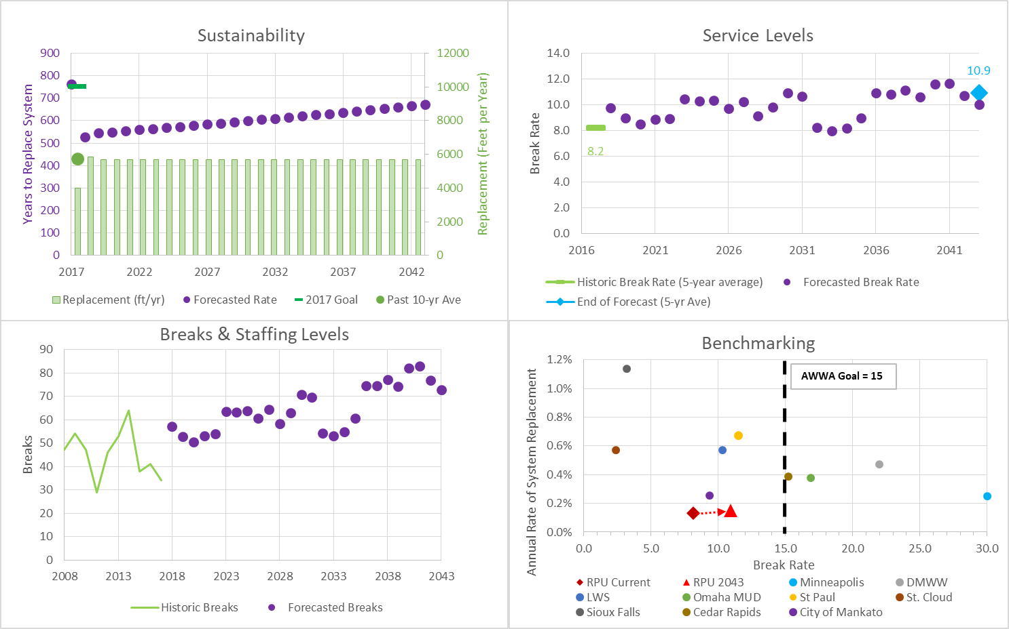
Scenario A – Business as Usual
Key Assumptions – Scenario A
5,700 ft/yr – initial renewal level
0% - annual increase in renewal level
75% - effectiveness of replacement
Notes:
Last five years vs 2017

Slide 15
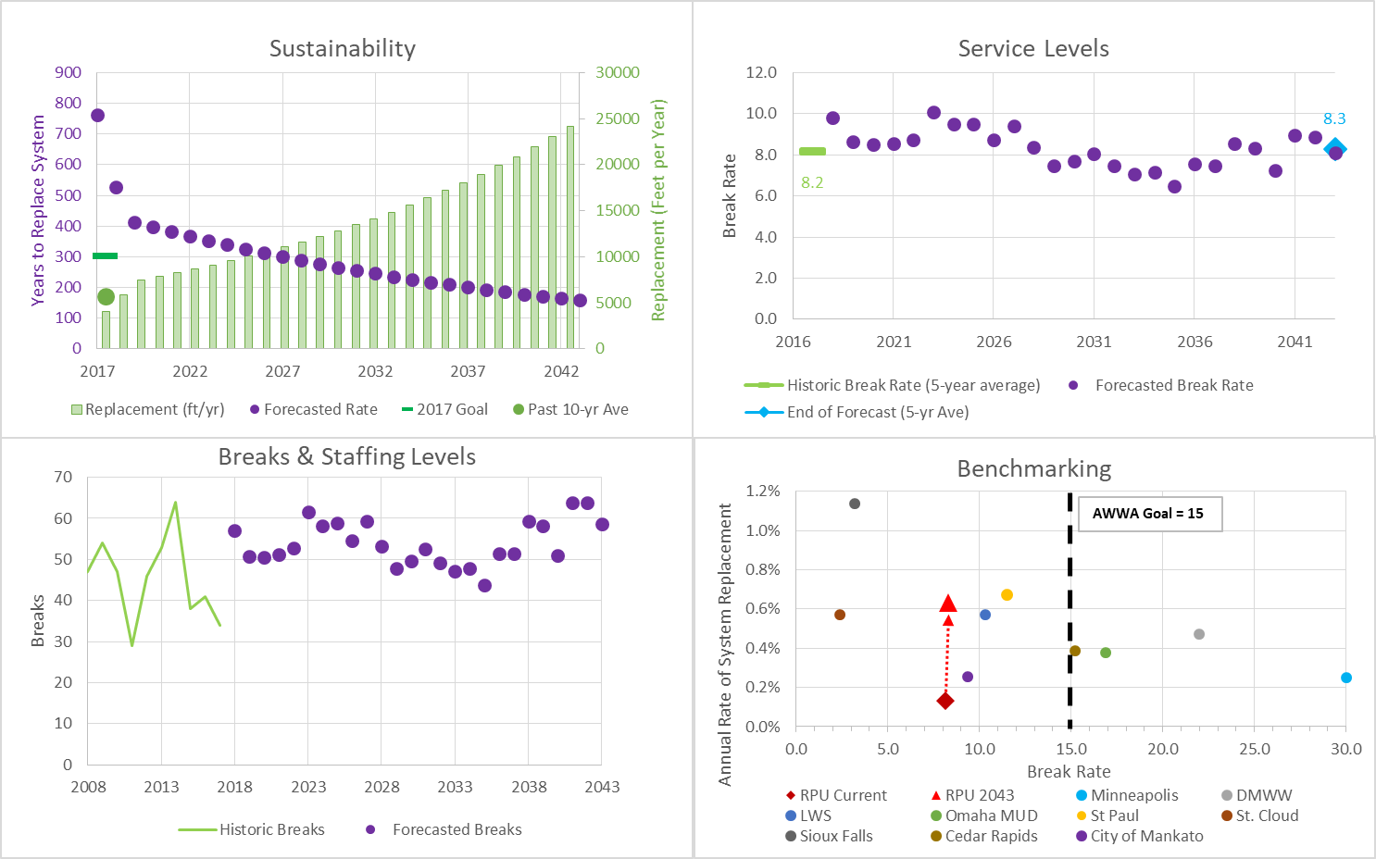
Scenario B – Maintain Existing Service Levels
Key Assumptions – Scenario B
7,500 ft/yr – initial renewal level
5% - annual increase in renewal level
75% - effectiveness of replacement

Slide 16
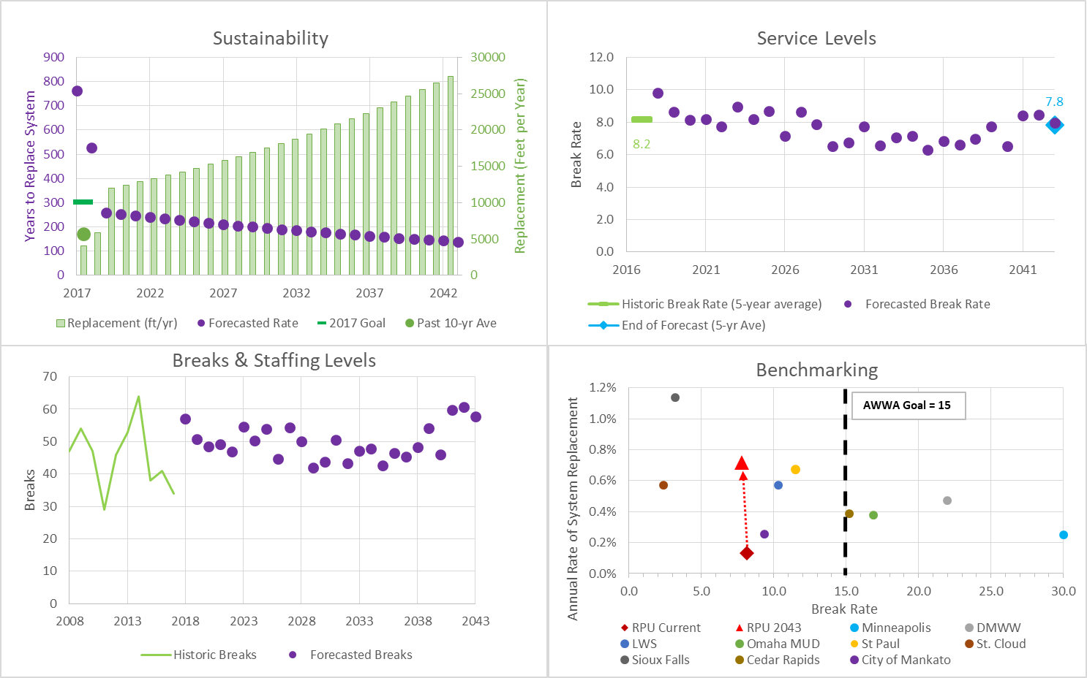
Scenario C – Improve Service Levels
Key Assumptions – Scenario C
12,000 ft/yr – initial renewal level
3.5% - annual increase in renewal level
75% - effectiveness of replacement

Slide 17
Next Steps
04

Slide 18
Next Steps
Phase 1 – Break Data and Service Level Analysis including Likelihood of Failure (LoF) Analysis
Completed 2nd Quarter 2018
Phase 2 – Risk Prioritization (LoF and Consequence of Failure Analysis)
Complete Early 1st Quarter 2019
Phase 3 – Capital Improvement Planning
Complete Late 1st Quarter 2019
Notes:
Doug is going to cover this.

Slide 19
Questions?

Slide 20
Benchmarking Survey Results
Reference Utility | System Length, mi | Break Rate¹ | Current Length Replaced¹, mi | Replacement Ratio
Rochester Public Utilities | 578 | 8 | 1.1 | 0.19%
City of Minneapolis Water | 1,100 | 30 | 2.8 | 0.25%
Des Moines Water Works | 1,441 | 22 | 6.8 | 0.47%
Lincoln Water System | 1,225 | 10 | 7.0 | 0.57%
Metropolitan Utilities District | 2,928 | 17 | 11.0 | 0.38%
St. Paul Regional Water Services | 1,185 | 11 | 8.0 | 0.68%
City of St. Cloud | 302 | 2 | 1.7 | 0.57%
City of Sioux Falls | 1,056 | 3 | 12.0 | 1.14%
City of Cedar Rapids | 671 | 15 | 2.6 | 0.39%
City of Mankato | 257 | 9 | 0.7 | 0.26%
Notes:
Communities of similar or larger size; older systems; core with a lot of development
Not “peer”; Upper Midwest communities

Slide 21
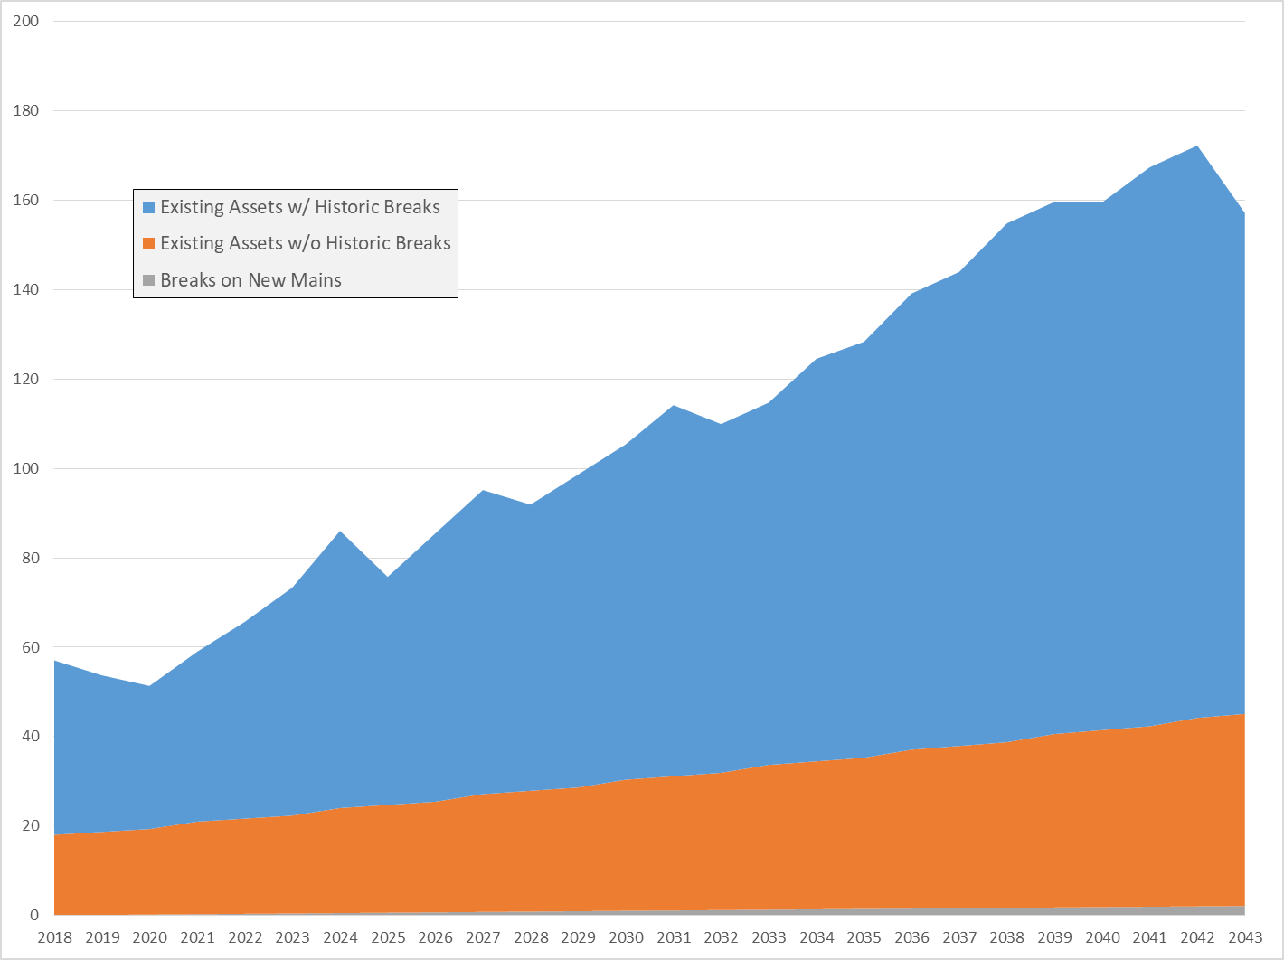
Break Forecast – 3 Components

Slide 22
Notes:
Need to explain explicitly what each of these are.

Slide 23
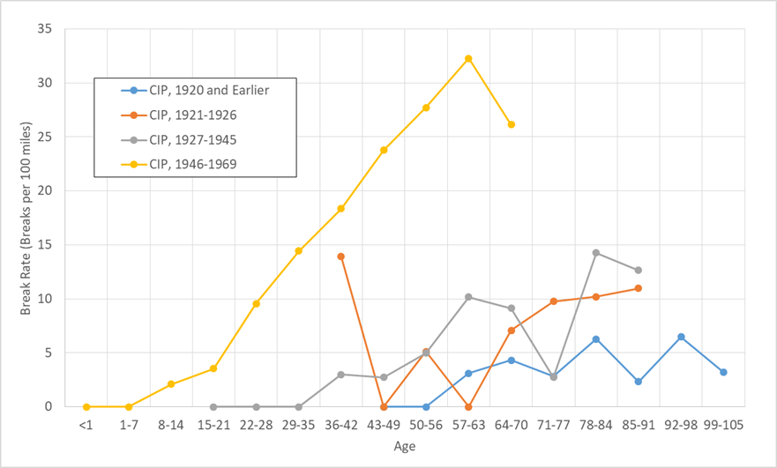
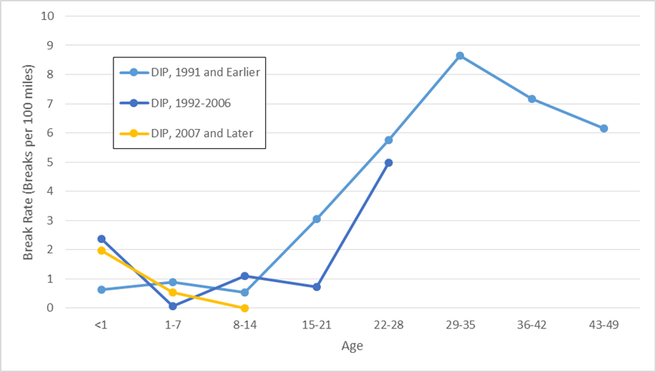

Slide 24
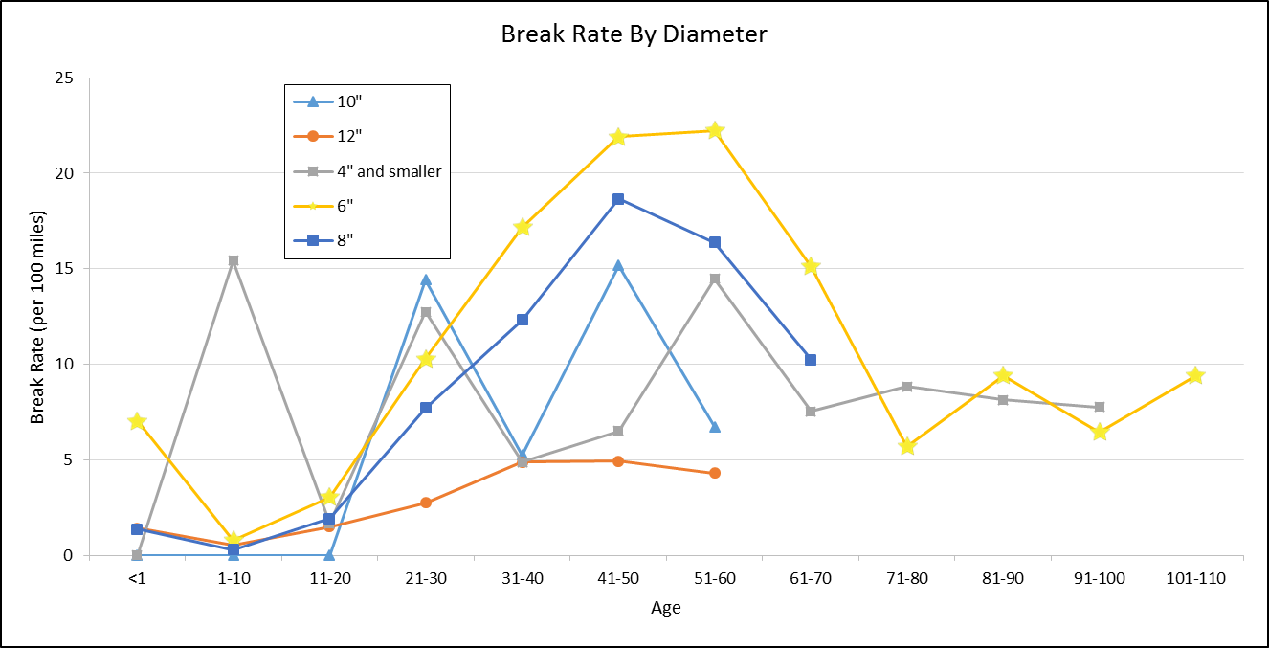
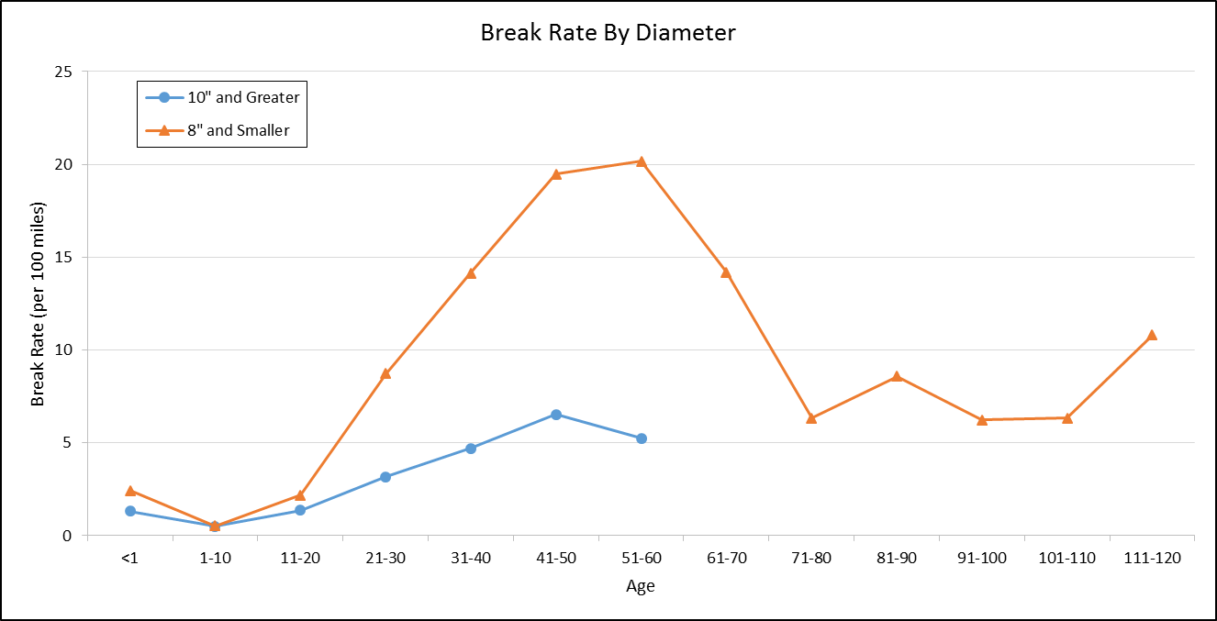

Slide 25
Main Break Analysis - Results
Primary and secondary drivers of deterioration determined by analysis
Material Vintage (age and material) - Primary
Diameter - secondary
Soil Data (Shrink/swell, Steel Corrosion, & Frost Heave) - secondary
Number of Taps
Pressure
These factors will be used in prioritization (Phase 2)

