Slide 1
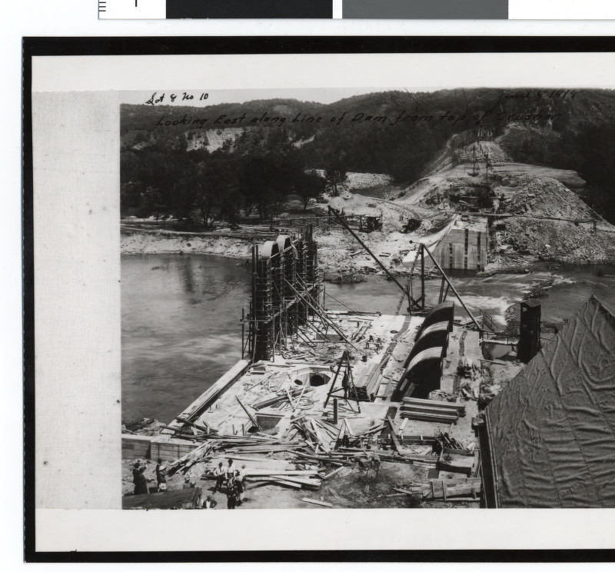
Construction of the Lake Zumbro Dam stared in 1917, supervised by renowned hydroelectric engineer Hugh L. Cooper
Notes:
Winter 1918 early construction

Slide 2
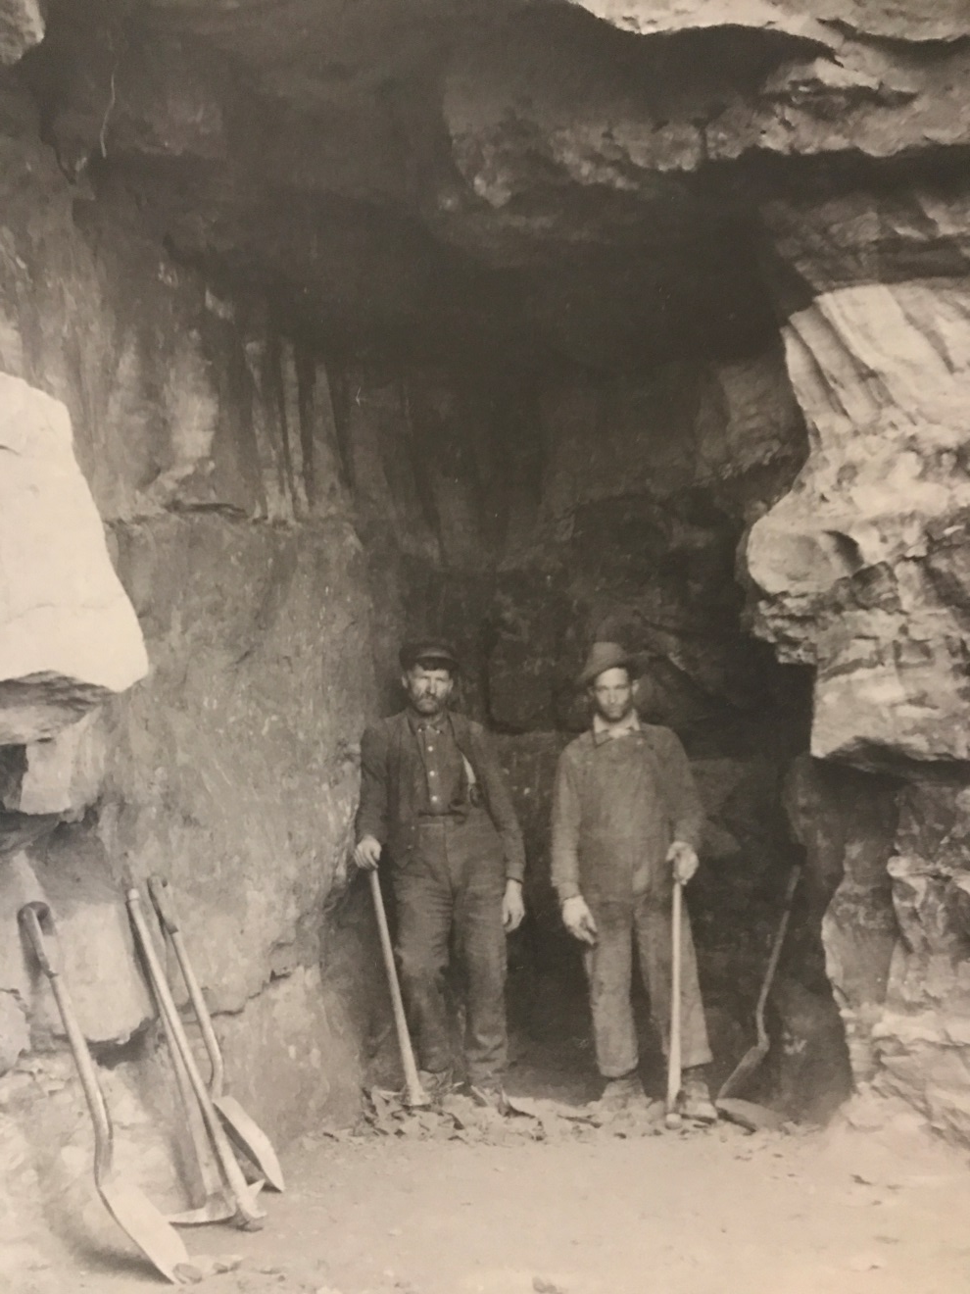
Two laborers pause with pick and shovel, prepping the future site of the Lake Zumbro Dam

Slide 3
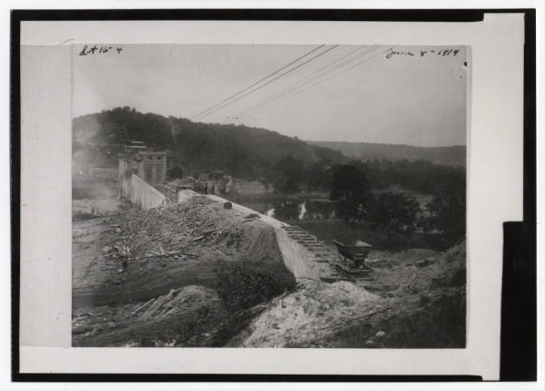
In this picture from 1919, a small piece of the rail system can be seen. It was used to get supplies out to the builders on the dam

Slide 4
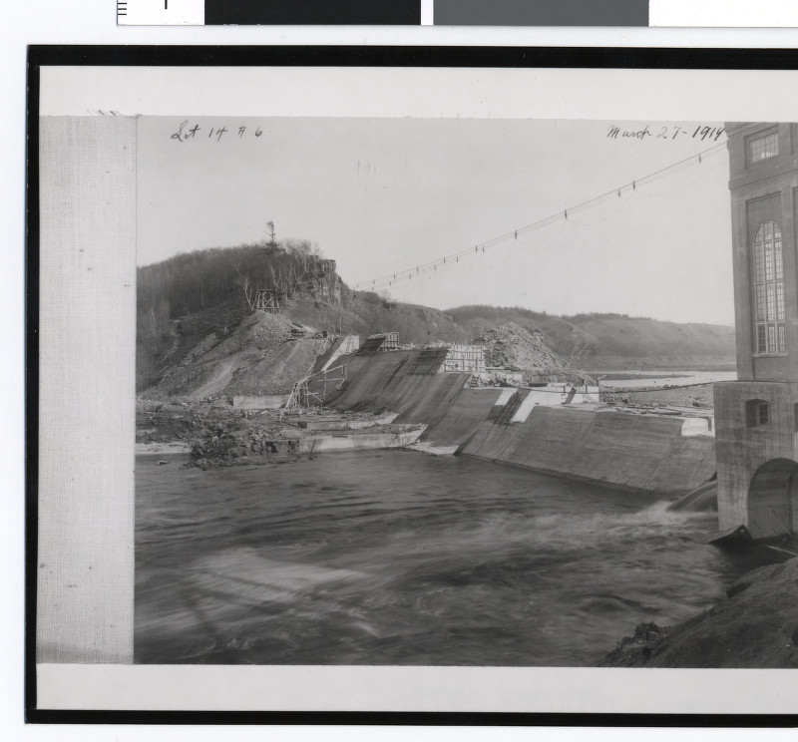
Notes:
March 27th 1919 spillway of the Dam being built

Slide 5
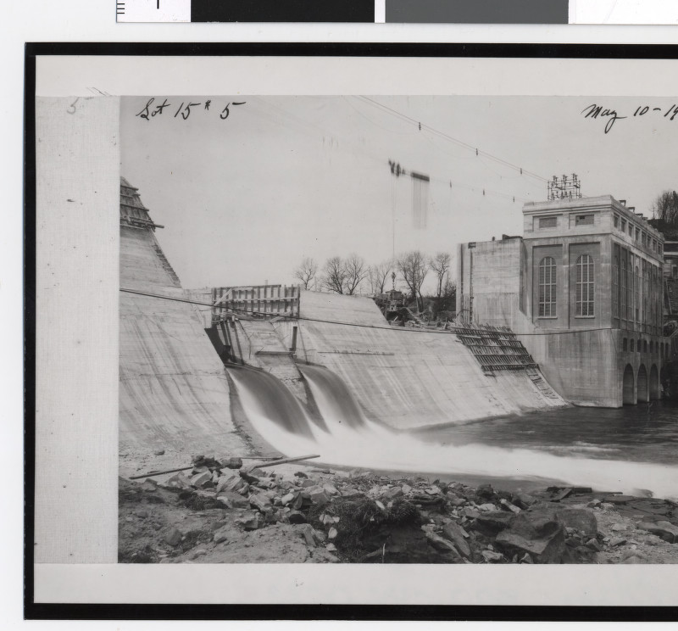
Notes:
May 10th 1919

Slide 6
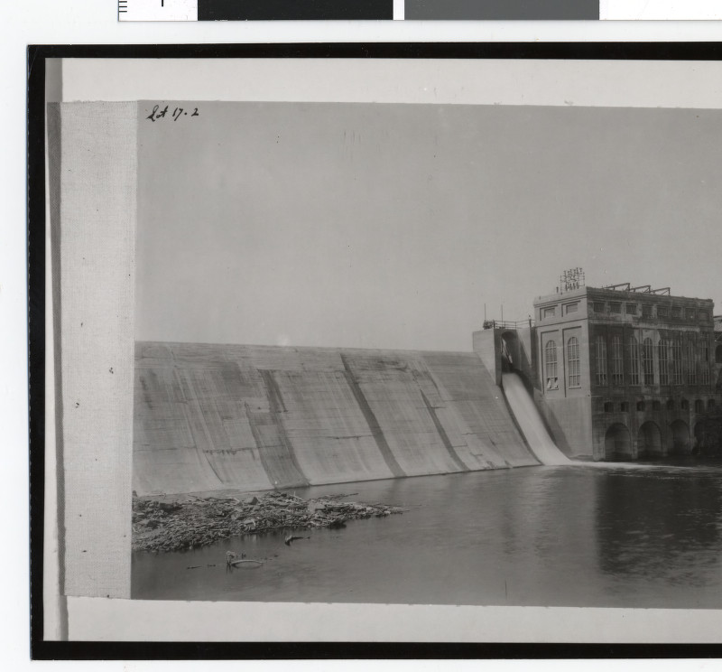
The powerhouse was placed into service on November 7th 1919
Notes:
Just finished dam circa 1920

Slide 7
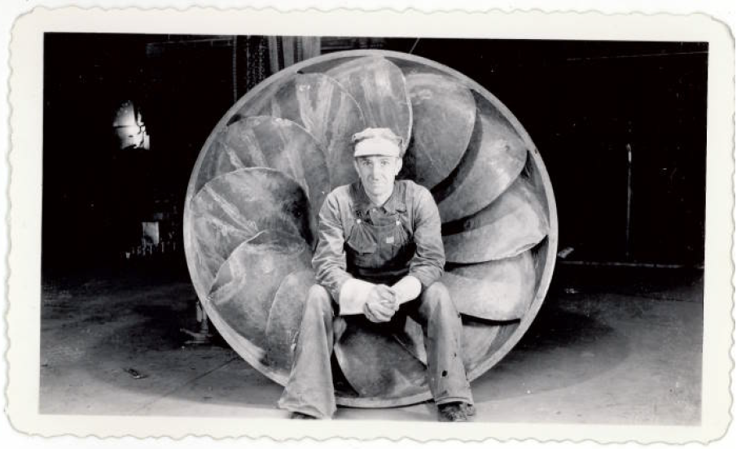

Slide 8
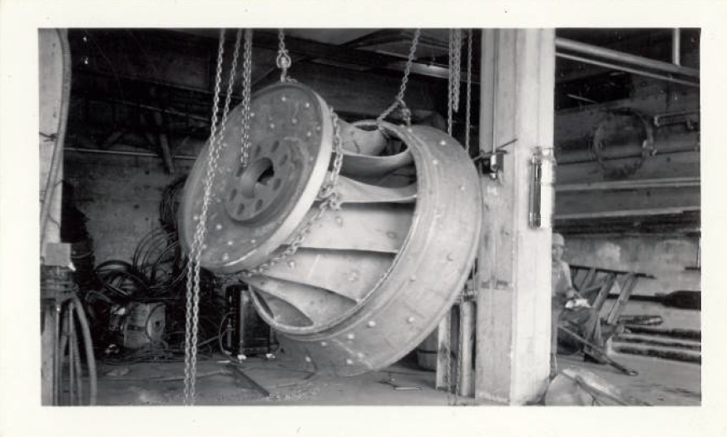

Slide 9
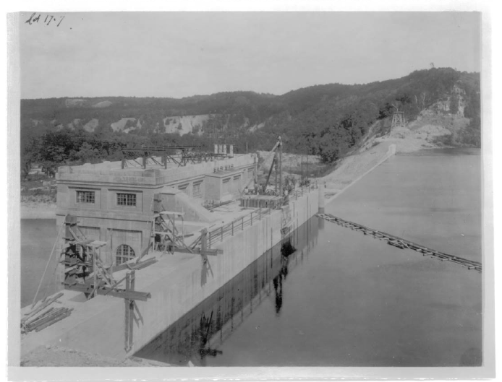
As soon as construction was finished, a debris boom was installed to catch large objects such as logs from causing damage to the dam.
Notes:
Original Debris Boom

Slide 10
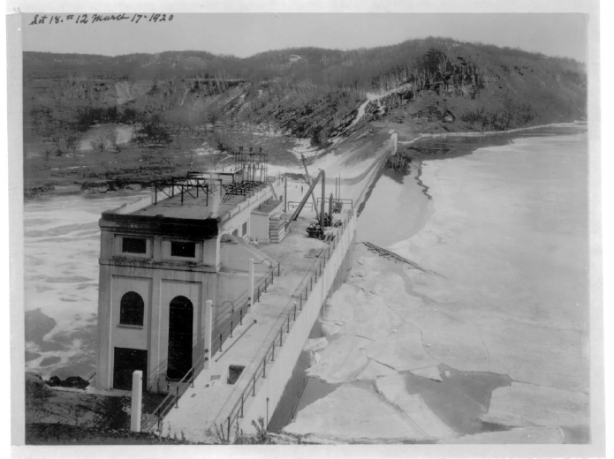
In this image from early spring 1920, ice can be seen breaking up by the dam, after its first winter in service.
Notes:
March 17th 1920 Ice at the Hydro

Slide 11
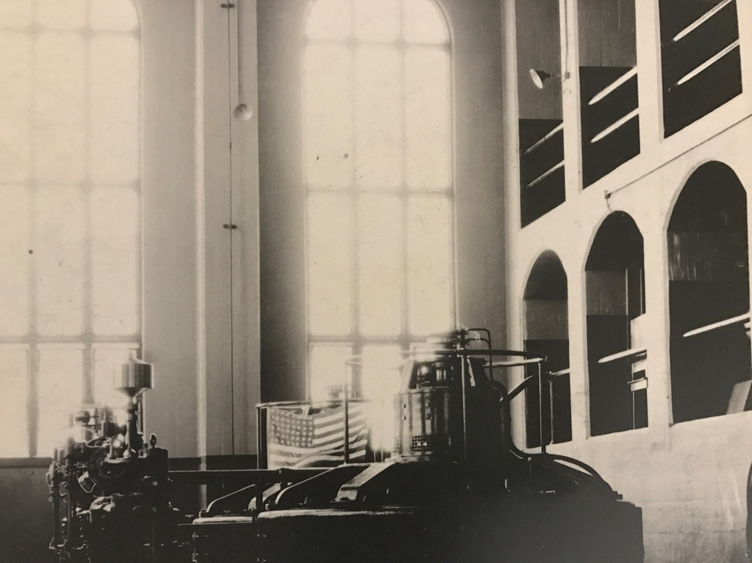
In 1919, the Lake Zumbro Dam, along with the North Broadway Plant, were able to produce enough energy for 60,000 residents during that era, much more than Rochester’s population needed at the time.
Notes:
48 star flag used from 1912 to 1959

Slide 12
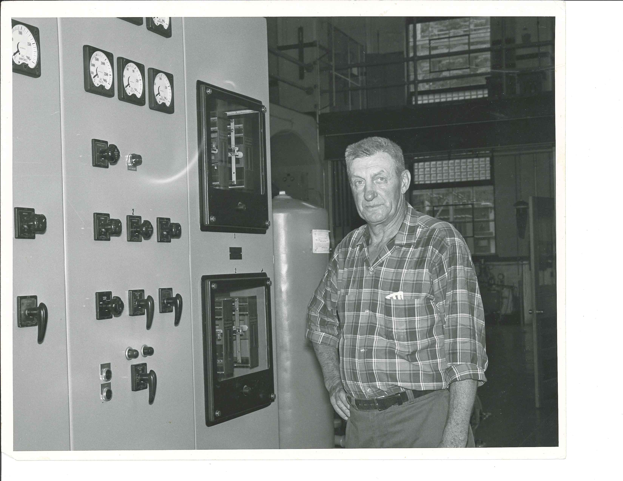
Remote controls were developed for the operators in 1961, making work safer and more efficient for operators like Ed Haling, pictured here.
Notes:
Ed Haling- Lived in one of the hydro cottages, last operator of the 1960’s

Slide 13
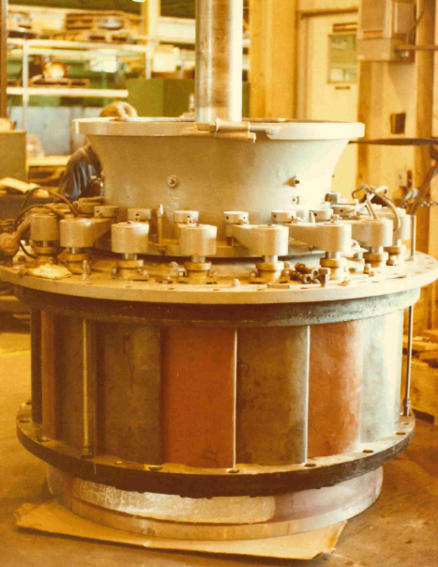
Notes:
Taken in 1982 during the shop assembly inspection, not sure what this is?

Slide 14
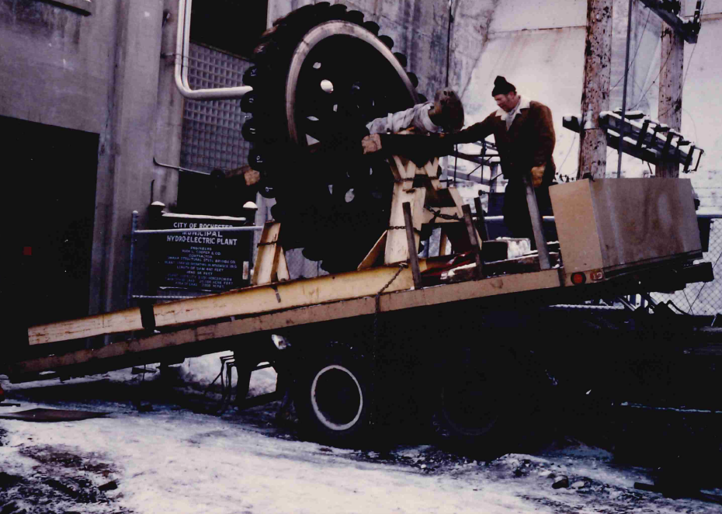
Notes:
Taken in December 1983

Slide 15
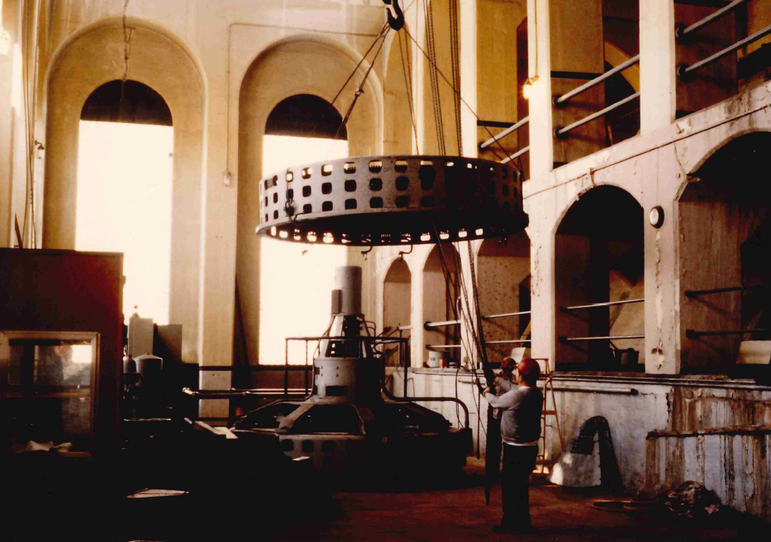
Notes:
Taken in 1983

Slide 16
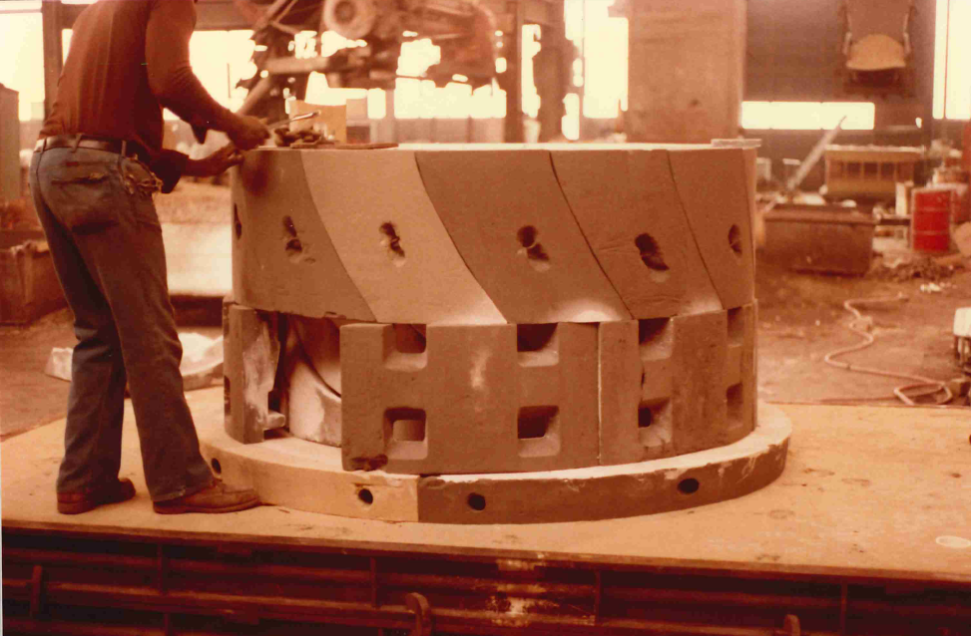
Notes:
Taken in march 1984, is some sort of mold being opened, says Teledyne Ohio Cast on the back, which is a steel company

Slide 17
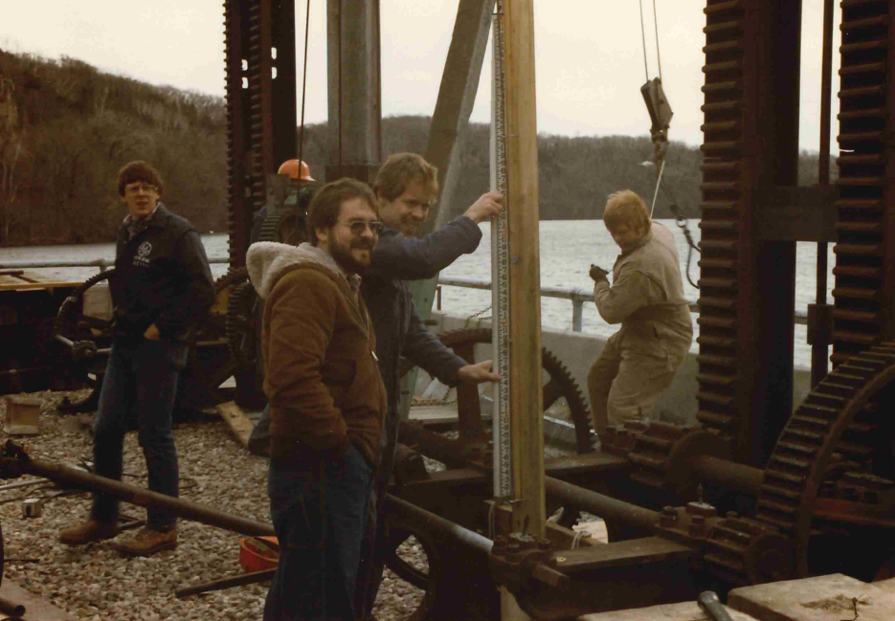
Notes:
Taken in November 1984

Slide 18
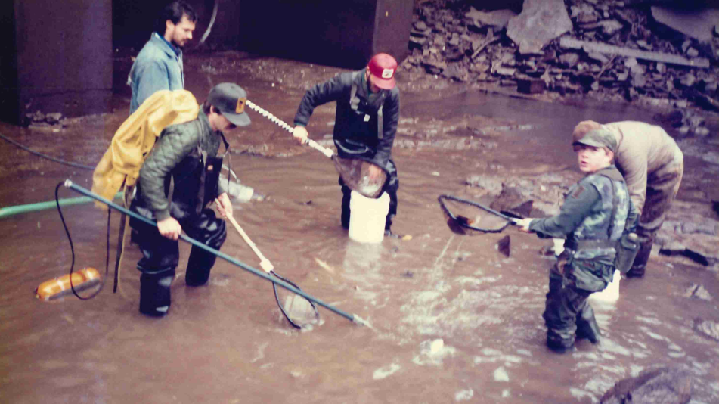
Notes:
From 10/20/1988, crew members are catching fish after lowering water levels and moving them back to higher water levels

Slide 19
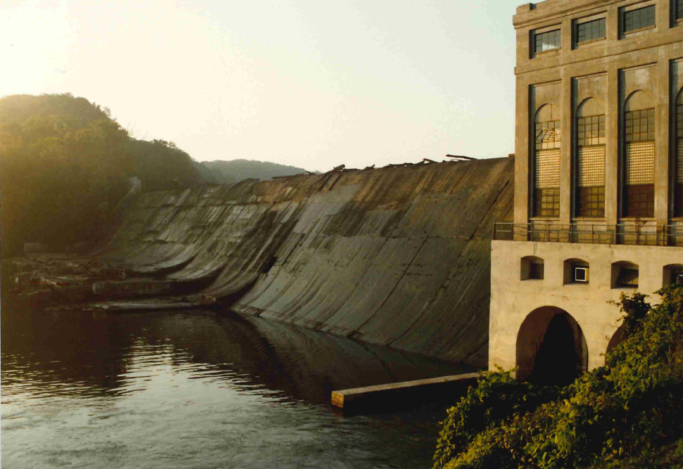
Notes:
Taken in 1987 while fixing the spillway of the dam

Slide 20
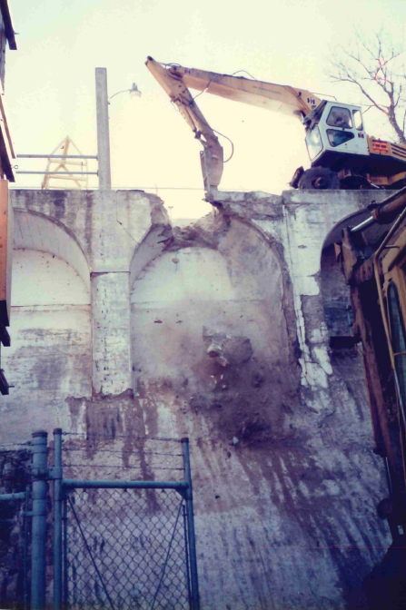
Notes:
From December 1989, construction crews are taking out the arch to put in a new one

Slide 21
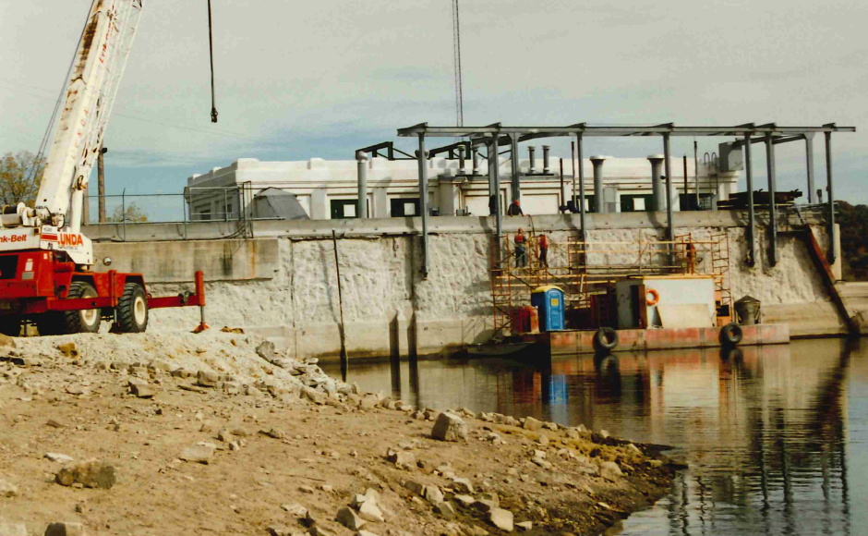
Notes:
Taken during the early 90s

Slide 22
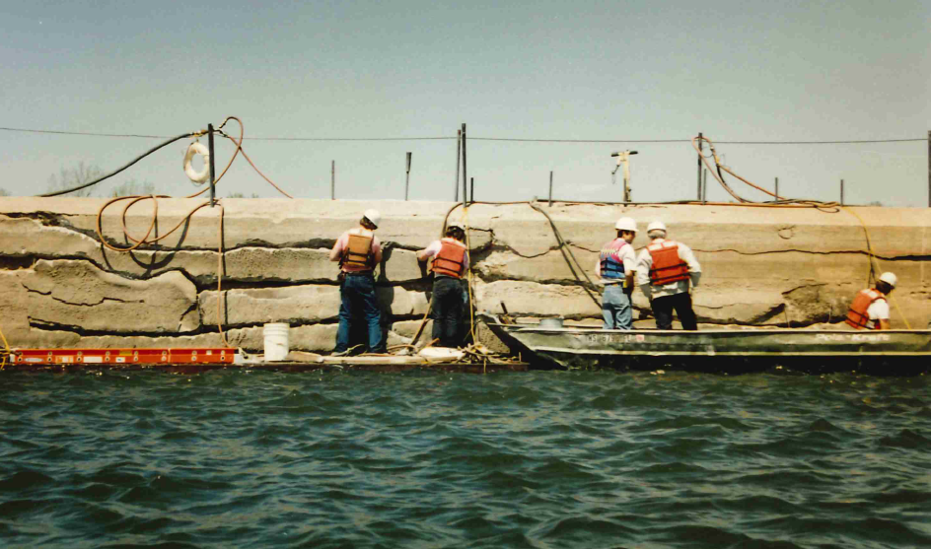
Notes:
Crews fix large cracks in the dam in 1992

Slide 23
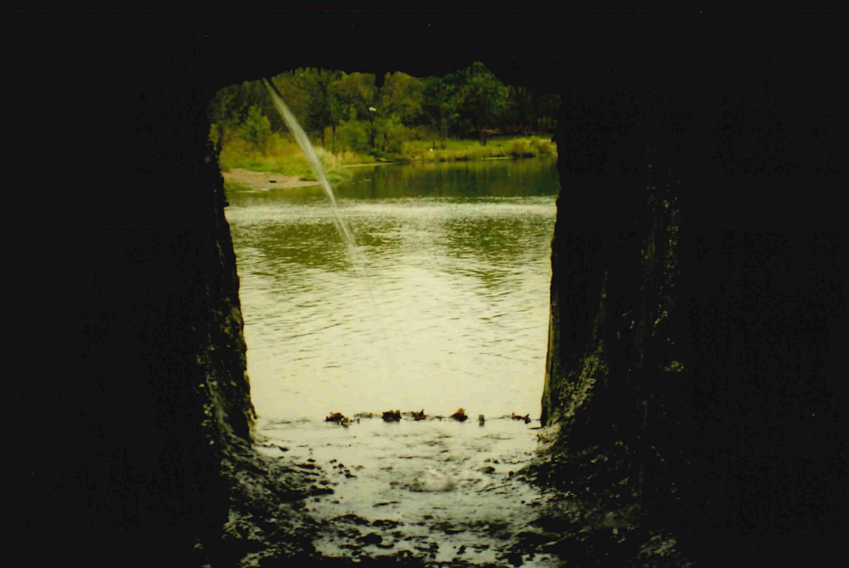
Notes:
From October 1994, inside a rewatering tunnel of the dam

Slide 24
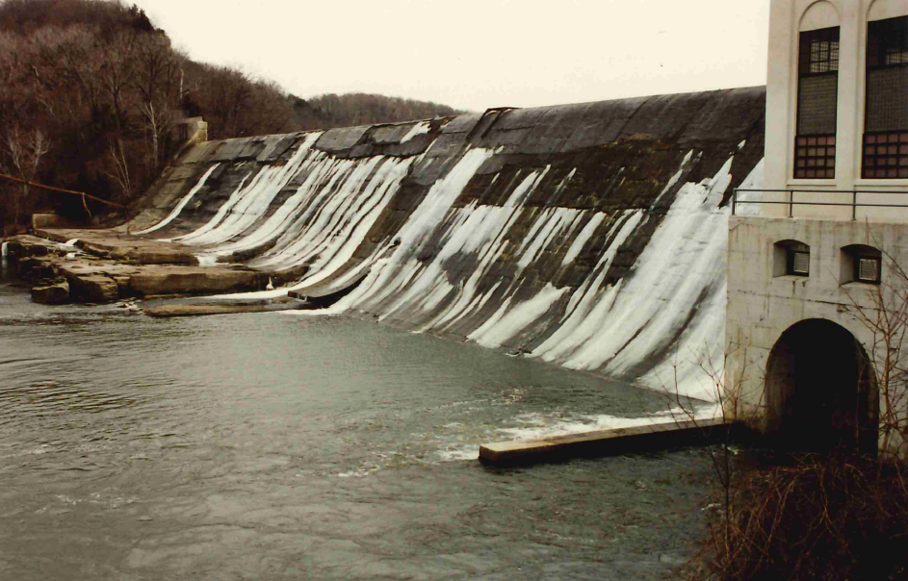
Notes:
From April 5th 1995, frozen water leaking through the dam

Slide 25
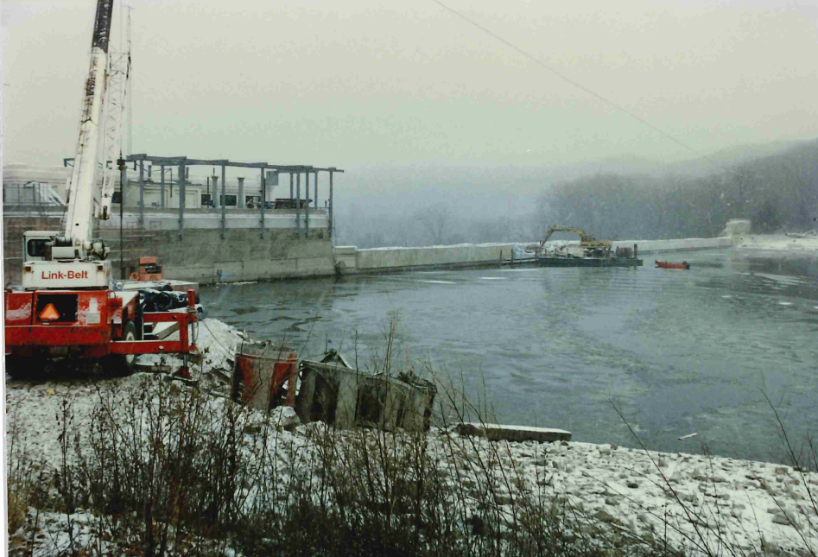
Notes:
Winter 1995

Slide 26
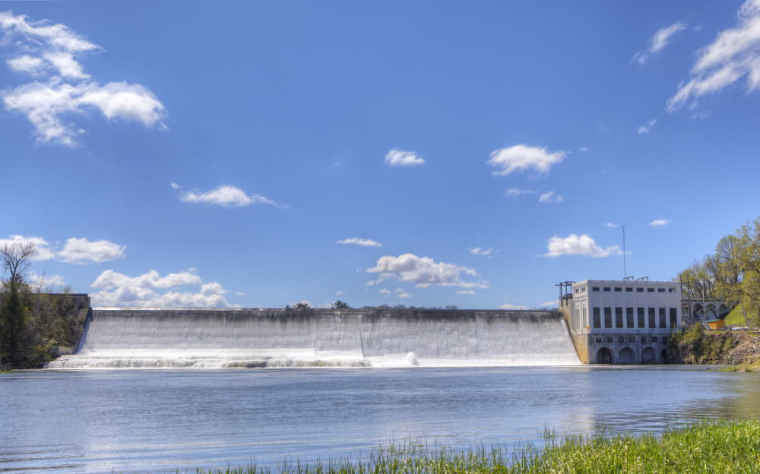
The Lake Zumbro Dam spans 440 feet and is 55 feet tall

Slide 27
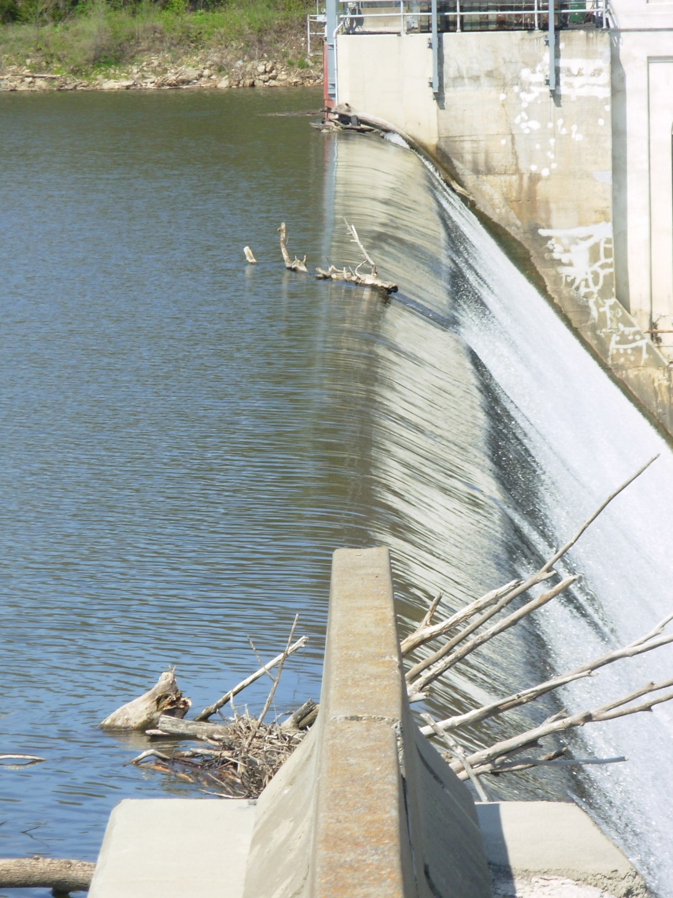
An new debris dam will be installed in the fall of 2017 to prevent logs and other large objects from causing damage to the dam

Slide 28
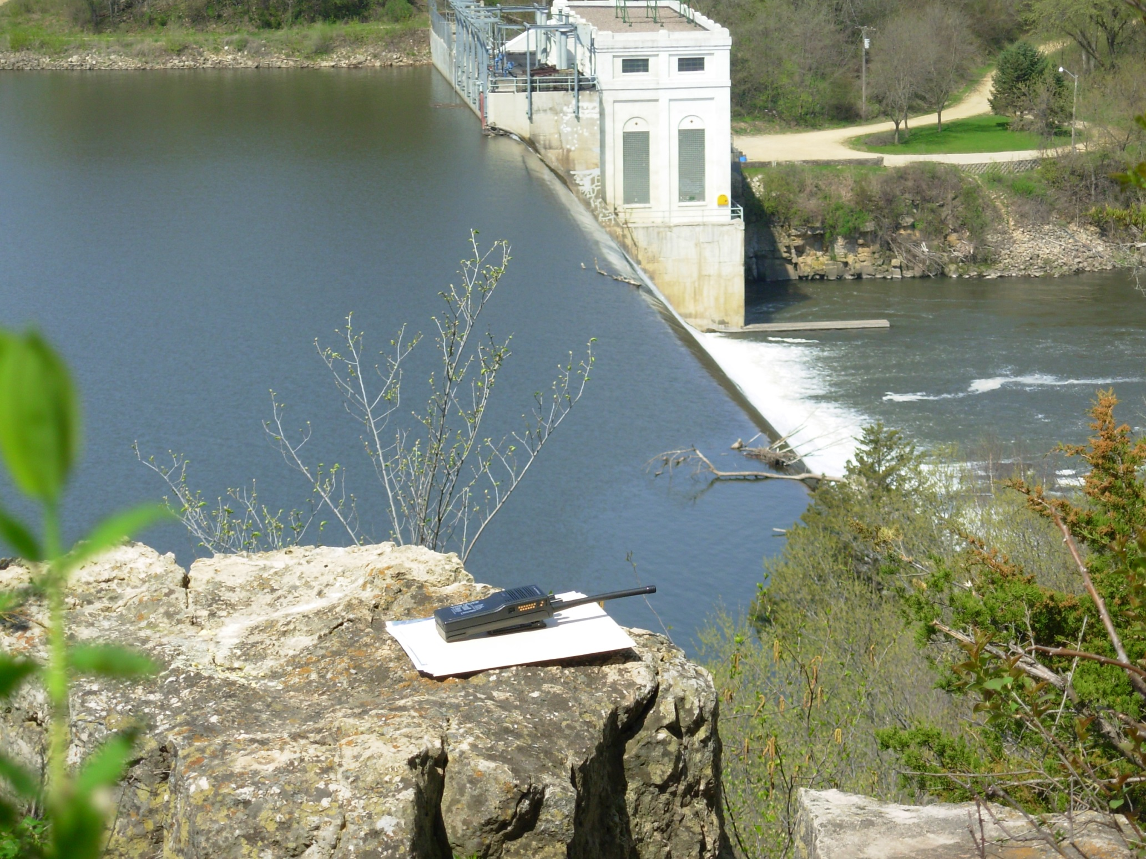
The dam is inspected annually, with major inspections happing every 5 years

Slide 29
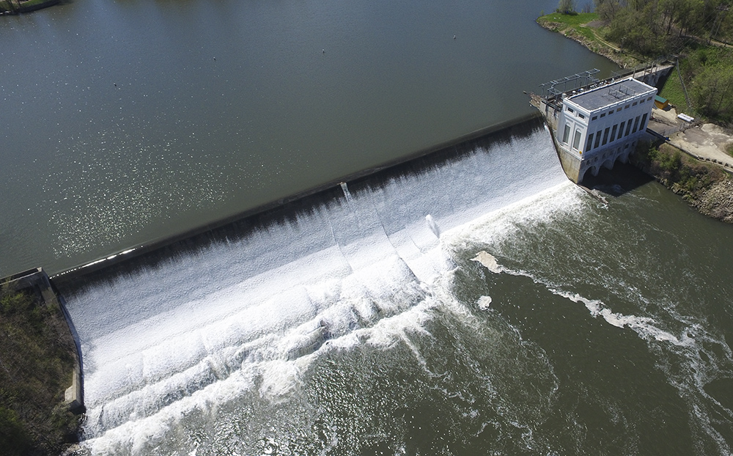
Warning buoys are placed 200 feet in front of the dam for the safety of all watercraft users or swimmers
Notes:
Aerial view: bouys

Slide 30
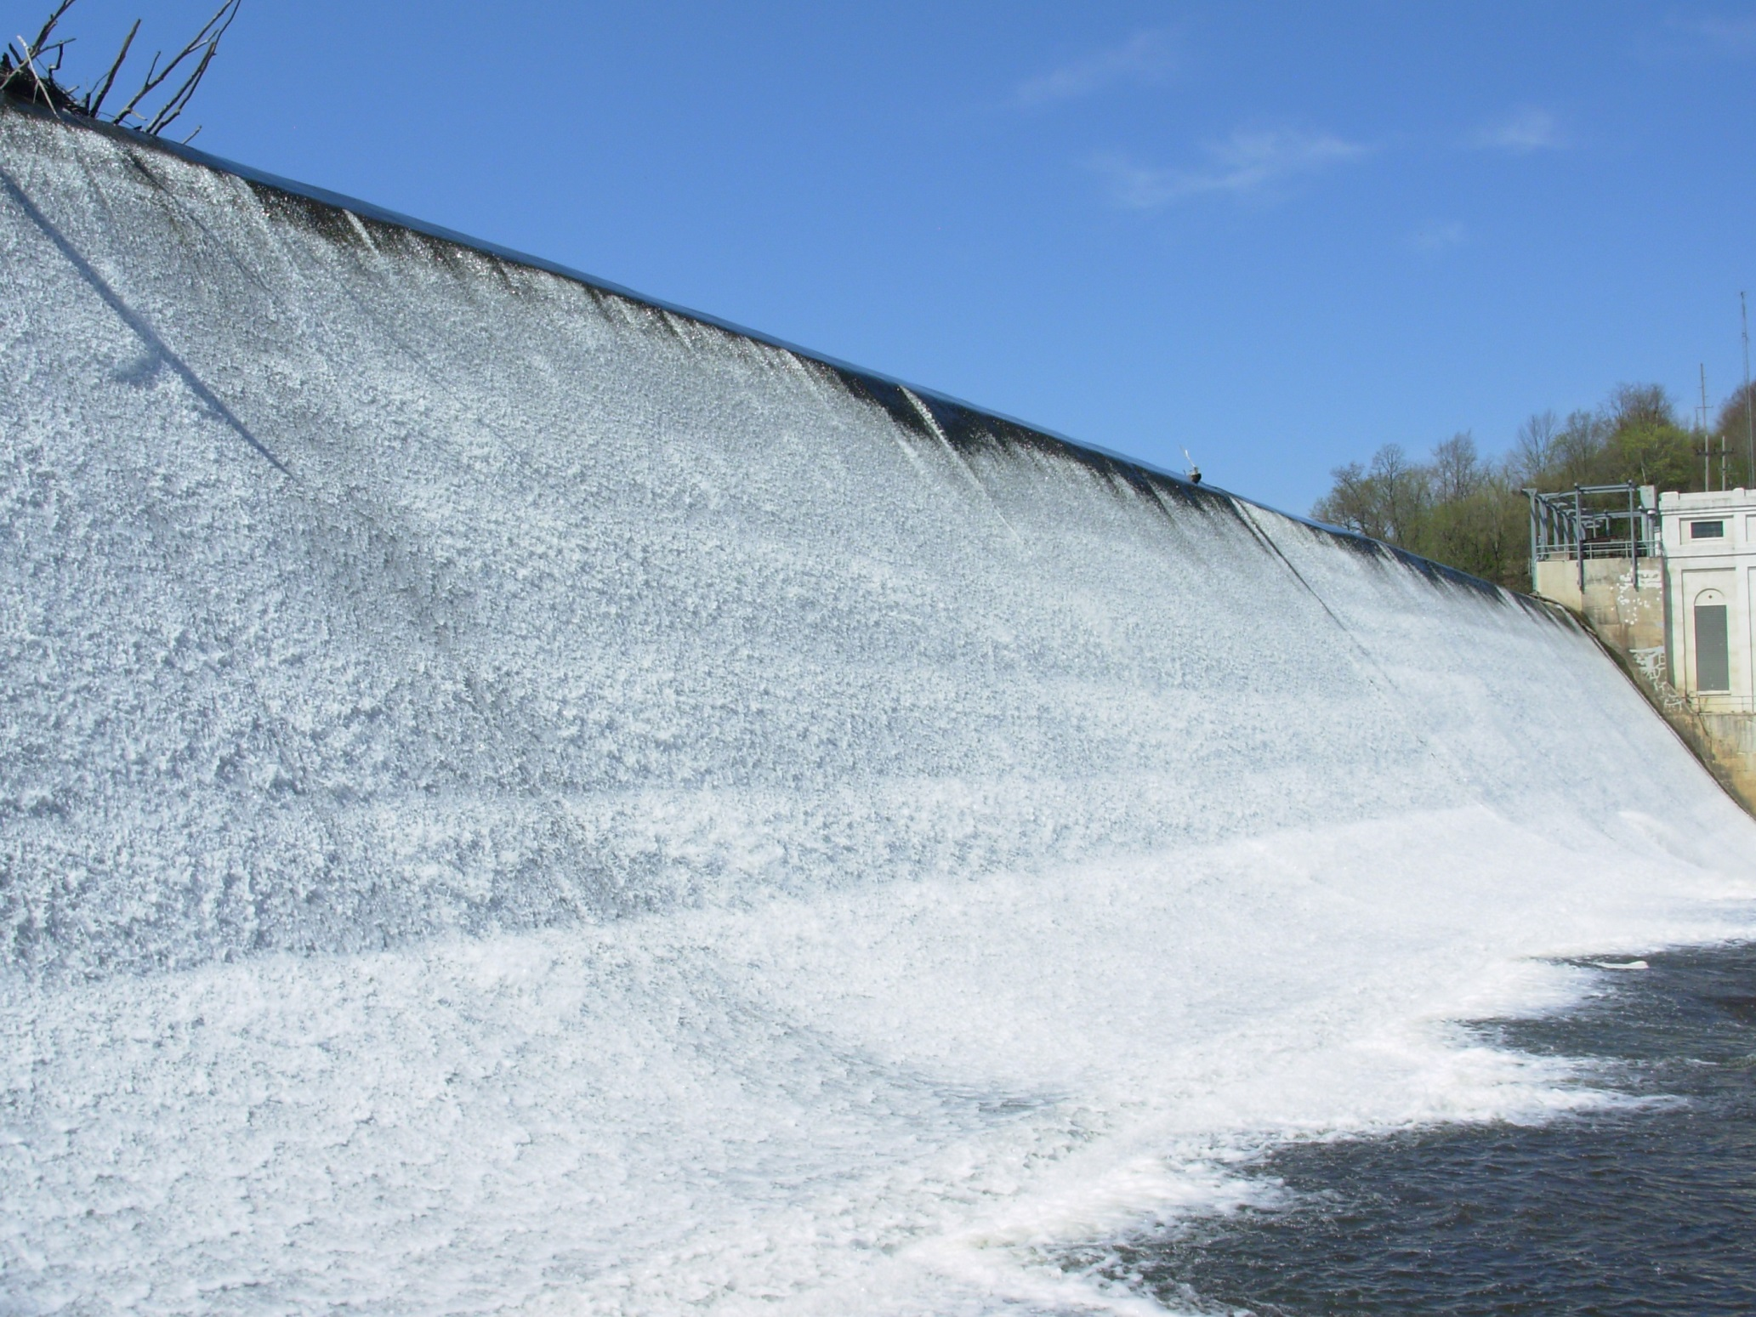
This is the spillway. If there is a foot of water going over that means about 1,500 cubic feet per second is going over the dam at any time
Notes:
FIX DESCRIPTION

Slide 31
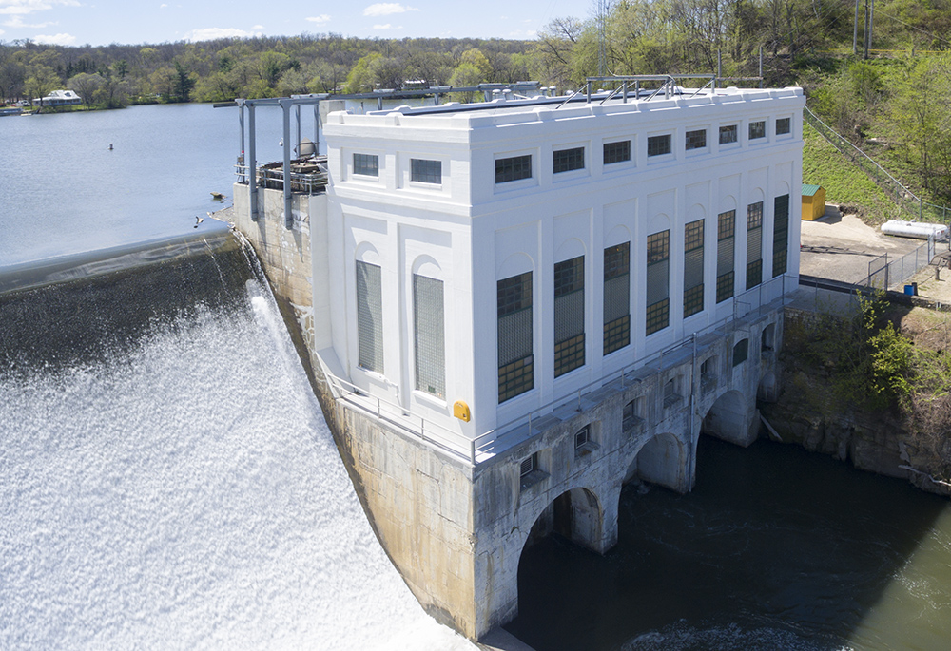
The Lake Zumbro Dam was placed on the National Record of Historic places in 1991, its architectural features cannot be changed
Notes:
Most recent pic

