Slide 1
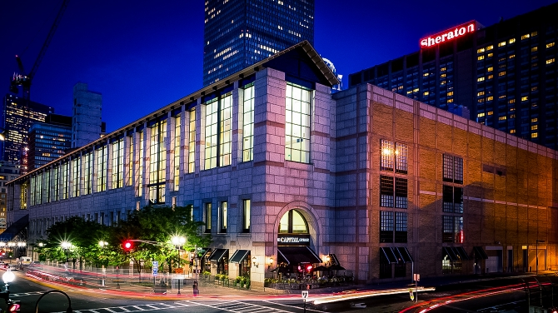
17th International Myeloma Workshop Hynes Convention Center ● Boston, USA September 12-15, 2019
www.imw2019boston.org

